Slide 1

AI in Medicine
Exploring Its Past, Present Uses, and Future Potential
Donald E. Moore, M.D., M.P.H.
Chair, MSSNY AI Taskforce
Adjunct Professor of Biology
Pace University

Slide 2
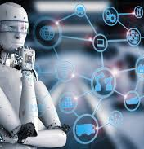
What is AI?
Artificial intelligence (AI) is a field of computer science that focuses on simulating human intelligence processes using computer systems.
AI learns
AI reasons
AI self-corrects
Agentic AI recognizes and processes information, learn, plans, and performs tasks to achieve specific goals. An intelligent agent perceives its environment through sensors and interacts with it via actuators, all guided by defined objectives.
Notes:
Artificial intelligence (AI) is a field of computer science that focuses on simulating human intelligence processes using computer systems.
AI learns- the acquisition of information and rules for usage
AI reasons- the ability to solve problems and make decisions
AI self-corrects- enhances performance over time.
Agentic AI recognizes and processes information, learns, plans, and performs tasks to achieve specific goals. An intelligent agent perceives its environment through sensors and interacts with it via actuators, all guided by defined objectives.

Slide 3
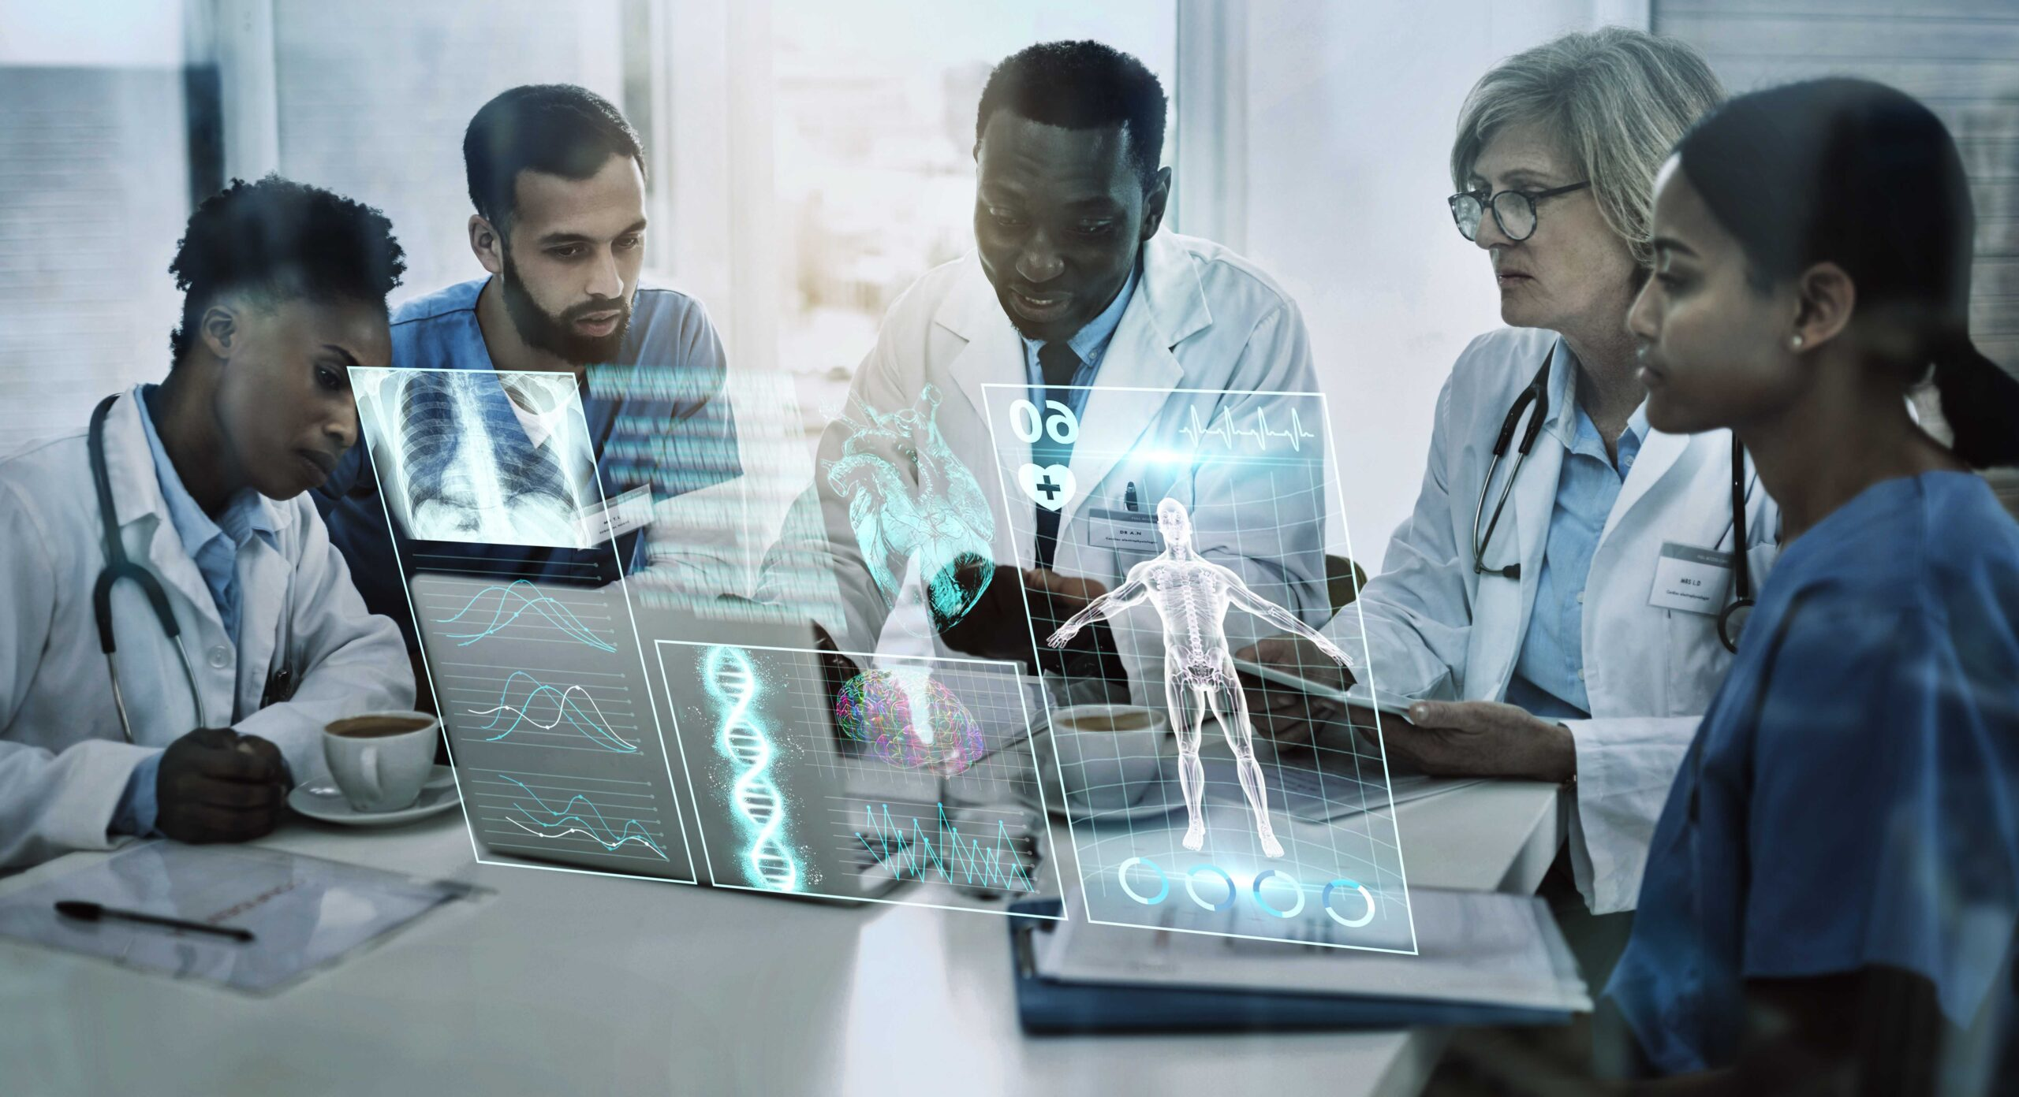
Artificial Intelligence (AI) in Medicine
AI in medicine: Advanced algorithms and computational techniques analyze complex medical data to support clinical decision-making and enhance patient care.
AI can:
enhance diagnostic accuracy,
personalize treatment plans,
accelerate drug discovery, and
streamline administrative tasks.
Notes:
AI in medicine uses advanced algorithms and computational techniques to analyze complex medical data, support clinical decision-making, and improve patient care.
AI can:
enhance diagnostic accuracy,
personalize treatment plans,
accelerate drug discovery, and
streamline administrative tasks.
The World Health Organization states that “AI can augment the ability of health-care providers to improve patient care, provide accurate diagnoses, optimize treatment plans, support pandemic preparedness and response, inform the decisions of health policymakers, or allocate resources within health systems.”

Slide 4
Types of Artificial Intelligence
Narrow artificial intelligence is used for specific tasks
Reading X-rays and slides
Translating languages,
Operating autonomous
vehicles
Playing games.
General AI or artificial general intelligence (AGI) performs multiple complex tasks
Understands ideas and concepts,
Engages in general problem-solving
Exhibits common sense
Learns from experience
Demonstrate emotional intelligence.
Superintelligent artificial intelligence would surpass human intelligence
Persuasion
Negotiation.
Solving climate change
accelerates technological progress.
Notes:
Narrow artificial intelligence is used for specific tasks, such as reading X-rays and pathology slides, translating languages, operating autonomous vehicles, and playing games.
General AI or artificial general intelligence (AGI) refers to systems that can perform multiple complex tasks, understand ideas and concepts, engage in general problem-solving, exhibit common sense, learn from experience, and demonstrate emotional intelligence.
Superintelligent artificial intelligence is a form of AI that would surpass human intelligence in various areas, including persuasion and negotiation. It would be capable of solving significant global challenges, such as climate change, and accelerate technological progress, including the discovery of cures for diseases currently considered incurable.

Slide 5

Understanding Artificial Intelligence and Augmented Intelligence
Artificial intelligence does not exist independently of humans
AI is designed, developed, and trained by humans.
It lacks consciousness, emotions, and understanding.
Augmented intelligence uses AI technology to enhance and extend human cognitive abilities.
Collaboration between humans and machines
Enables informed decision-making, facilitates problem-solving, and enhances productivity.
Humans provide creativity, intuition, and ethical judgment, while AI offers data processing, pattern recognition, and computational power.
Notes:
Artificial intelligence does not exist independently of human intelligence. AI is designed, developed, and trained by humans using algorithms, data, and frameworks created by people.
It lacks consciousness, emotions, and understanding.
Augmented intelligence refers to the use of AI technology to enhance and extend human cognitive abilities rather than replace them.
This concept emphasizes collaboration between humans and machines
AI tools enable informed decision-making, facilitate problem-solving, and enhance productivity. .
Humans provide creativity, intuition, and ethical judgment, while AI offers data processing, pattern recognition, and computational power

Slide 6
AI and Digital Biology
Digital biology combines biology with computational and digital technologies.
Bioinformatics- software and algorithms analyze biological data. Genomics, transcriptomics, and proteomics.
Synthetic biology merges biology and engineering to design and create new biological parts, devices, and systems.
Data integration combines biological data from different sources to gain comprehensive insights into biological questions.
Computational biology- mathematical models and simulations comprehend biological systems and predict their behavior.
Notes:
Digital biology combines biology with computational and digital technologies.
Bioinformatics utilizes software and algorithms to analyze biological data, including genomics, transcriptomics, and proteomics.
Computational biology utilizes mathematical models and simulations to comprehend biological systems and forecast their behavior.
Synthetic biology merges biology and engineering to design and create new biological parts, devices, and systems. It often utilizes digital tools for modeling and design.
Data integration combines various types of biological data from different sources to gain comprehensive insights into biological questions
The Nobel prize for chemistry in 2024 was awarded to biochemist David Baker for computational protein design, and neuroscientist Demis Hassabis and computer scientists John Jumper for protein structure prediction.

Slide 7
Historical Context
1950s- intelligent systems that could replicate human decision-making in diagnosis and treatment.
Alan Turing wrote the 1950 paper, ‘Computing Machinery and Intelligence,’ published in the journal Mind.
1961- A computer was introduced into medicine for diagnosis
1952- Punched cards were used for the differential diagnosis of hematologic diseases.
1956 Dartmouth Summer Research Project on Artificial Intelligence, organized by John McCarthy
Notes:
The use of computers in medicine dates to the 1950s, when early efforts aimed to create intelligent systems that could replicate human decision-making in diagnosis and treatment.
Alan Turing, a pioneer in artificial intelligence, introduced the concept of machine intelligence in his seminal 1950 paper, ‘Computing Machinery and Intelligence,’ published in the academic philosophical journal Mind.
The 1956 Dartmouth Summer Research Project on Artificial Intelligence, organized by John McCarthy, is considered the foundational event that established artificial intelligence (AI) as a distinct field of study.
In 1952, punched cards were used to automate the correlation of data in the differential diagnosis of hematologic diseases. In 1961, a computer was introduced into medicine for this purpose.

Slide 8
Historical Context
1978 MYCIN assisted in diagnosing serious bacterial infections and recommending antibiotics. Rule-based logic
Late 20th-century machine learning enables computers to learn from data.
The Digitization of health records since the 1990s- EHRs, imaging, and genomic data) provided big data
2000-present- technological advancements in AI in medicine driven by machine learning, natural language processing, computer vision, and chip technology
Notes:
During the 1970s and 1980s, systems like MYCIN were developed to assist in diagnosing serious bacterial infections and recommending antibiotics. These systems relied on rule-based logic and were among the first attempts to apply AI in clinical settings.
The late 20th and early 21st centuries saw significant advancements in machine learning, a subset of AI that enables computers to learn from data.
The digitization of health records since the 1990s, along with the proliferation of medical data, has provided a rich source of information for AI systems to analyze. Electronic health records (EHRs), imaging data, and genomic data are now widely available for AI applications.
In the first two decades of the 21st century, significant technological advancements in artificial intelligence (AI) have been witnessed within the field of medicine. These advancements have been driven by developments in machine learning, natural language processing, computer vision, and chip technology (semiconductor design, speed, and capability)
1956 Dartmouth Summer Research Project on Artificial Intelligence, organized by John McCarthy

Slide 9
The Foundation of Artificial Intelligence The fundamental building blocks of artificial intelligence are data, algorithms, and computing power.
Data can affect the system's quality and biases. Structured (spreadsheets) or unstructured (free text), raw or cleaned. Big data, ranging from gigabytes to zettabytes, powers deep learning through its volume, velocity, and variety.
Algorithms should be deterministic, feasible, and terminating. Enable computer vision and data processing. Operate through linear regression, decision trees, neural networks, etc. Supervised, unsupervised, and reinforcement learning
Computing power drives AI, with algorithms and data as foundations. AI's demands, especially in deep learning, require robust hardware.
Notes:
The fundamental building blocks of artificial intelligence (AI) are data, algorithms, and computing power.
Data influences both the quality and biases of the system. It can be structured like spreadsheets or unstructured such as free text, raw or cleaned. Big data, ranging from gigabytes to zettabytes, drives deep learning through its volume, velocity, and variety.
Algorithms optimize processes and automate tasks. They should be deterministic, feasible, and terminating. They operate through linear regression, decision trees, neural networks, and many other models They enable computer vision and data processing. There are several types of learning algorithms, including supervised learning, which involves training with labeled data; unsupervised learning, which works with unlabeled data to identify patterns; and reinforcement learning, which utilizes rewards to guide learning through trial and error.
Computing power drives AI, with algorithms and data as foundations. AI's demands, especially in deep learning, require robust hardware.

Slide 10
Machine Learning Algorithms
Supervised learning- labeled datasets to map inputs to outputs. Enables predictions on unseen data. Classification and Regression. Uses linear regression, decision trees, and neural networks. Applications include image and speech recognition, medical diagnosis, email filtering, and more.
Unsupervised learning- unlabeled data. Identifies patterns and structures. Used for clustering and dimensionality reduction. Common algorithms: K-means clustering, hierarchical clustering, and principal component analysis (PCA). Applications: customer segmentation, anomaly detection, and data visualization.
Reinforcement learning (RL)- an agent learns by interacting with an environment to maximize cumulative rewards. Key components: agent, environment, states, actions, policies, rewards, and value functions. Learns from the consequences of actions. Applications in robotics, gaming, recommendation systems, and UAVs
Notes:
Supervised learning trains models on labeled datasets to map inputs to outputs, enabling predictions on unseen data. It includes classification and regression, using algorithms like linear regression, decision trees, and neural networks. Applications include image and speech recognition, medical diagnosis, email filtering, and more.
Unsupervised learning trains models on unlabeled data, identifying patterns and structures. It is used for clustering similar data points and dimensionality reduction, preserving essential characteristics while reducing feature count. Common algorithms include K-means clustering, hierarchical clustering, and principal component analysis (PCA). Applications include customer segmentation, anomaly detection, and data visualization.
Reinforcement learning (RL) is a machine learning approach where an agent learns to make decisions by interacting with an environment to maximize cumulative rewards. Key components include the agent, environment, states, actions, policies, rewards, and value functions. RL emphasizes learning from the consequences of actions, It has applications in robotics, gaming, recommendation systems, and autonomous vehicles.

Slide 11
Components of Artificial Intelligence
Machine learning- computers learn and improve from experience without requiring additional programming. Computers are trained using data and algorithms that employ supervised, unsupervised, and reinforcement learning.
Deep learning subset of machine learning uses multiple layers of artificial neural networks (ANNs), hence the term "deep", to analyze and learn from large amounts of data, such as large language models (LLMs).
Artificial neural networks, inspired by the human brain, used in various applications, including image analysis (e.g., X-rays, MRIs, CT scans), image and speech recognition, natural language processing, synthetic biology, drug discovery, and autonomous systems.
Types of neural networks, include convolutional neural networks (CNNs), recurrent neural networks (RNNs), variational autoencoders (VAEs), generative adversarial networks (GANs), transformer model, and feedforward neural networks.
Notes:
Machine learning is the capability of computers to learn and improve from experience without requiring additional programming. This process involves feeding computers data and algorithms, which are then trained through methods such as supervised, unsupervised, and reinforcement learning.
Deep learning is a subset of machine learning that uses multiple layers of artificial neural networks (ANNs), hence the term "deep", to analyze and learn from large amounts of data, such as large language models (LLMs).
Artificial neural networks, inspired by the human brain, are used in various applications, including image analysis (e.g., X-rays, MRIs, CT scans), image and speech recognition, natural language processing, synthetic biology, drug discovery, and autonomous systems.
There are several types of neural networks, including convolutional neural networks (CNNs), recurrent neural networks (RNNs), variational autoencoders (VAEs), generative adversarial networks (GANs), transformer model, and feedforward neural networks.

Slide 12
The Components of Artificial Intelligence
Natural language processing (NLP) enables machines to understand, interpret, and generate human language through text and speech: translation, speech recognition, and language comprehension.
Siri, Alexa, Google Translate, and sentiment analysis tools.
Robotics involves the use of machines to perform physical tasks traditionally carried out by humans, such as:
Driving, assembly line work, surgery, and exploration in challenging environments like space or hazardous areas.
Expert systems are designed to replicate the breadth and depth of human expertise by utilizing a knowledge base and decision-making skills.
Medical diagnosis and treatment, medical education, loan and investment decisions, insurance underwriting, and decision support systems.
Notes:
Natural language processing (NLP) enables machines to understand, interpret, and generate human language through text and speech. This includes tasks such as translation, speech recognition, and language comprehension, while considering tone, nuance, context, and syntax. Typical applications of NLP include chatbots like Siri and Alexa, Google Translate, and sentiment analysis tools.
Robotics involves the use of machines to perform physical tasks traditionally carried out by humans. This includes activities such as driving, assembly line work, surgery, and exploration in challenging environments like space or hazardous areas.
Expert systems are designed to replicate the breadth and depth of human expertise by utilizing a knowledge base and decision-making skills. Applications of expert systems can be found in medical diagnosis and treatment, medical education, loan and investment decisions, insurance underwriting, and decision support systems.

Slide 13
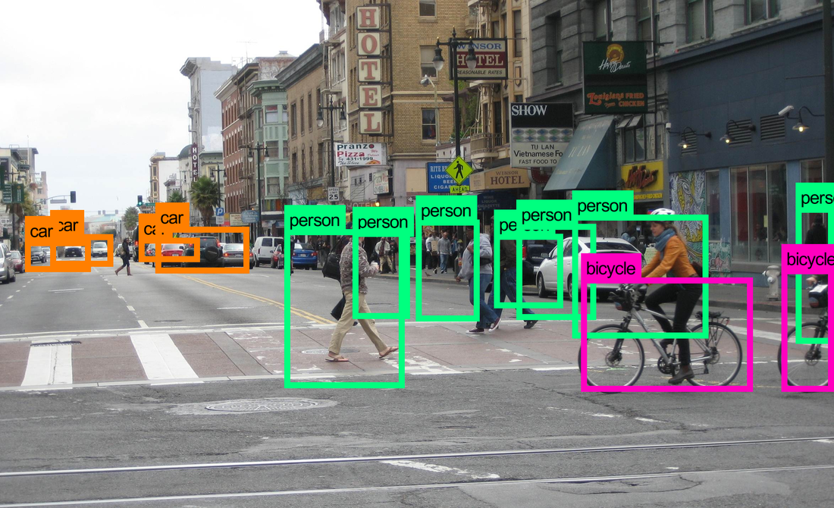
The Components of Artificial Intelligence
Computer vision perceives the surroundings using lidar, radar, sonar, and cameras.
Image recognition tasks- reading X-rays and slides, facial recognition for law enforcement, security, and surveillance applications.
driverless vehicles and autonomous
procedural medical technologies such as endoscopy (EGD, colonoscopy, and bronchoscopy) and minimally invasive robotic surgery.
Optical Character Recognition (OCR) uses ML and DL technologies like CNNs, RNNs, and transformers to:
digitize texts, automate data entry, manage prescriptions, handle billing, facilitate research, and enhance accessibility.
Notes:
Computer vision enables computers to perceive their surroundings using technologies such as lidar, radar, sonar, and cameras. This capability encompasses image recognition tasks, including reading X-rays and pathology slides, as well as facial recognition for law enforcement, security, and surveillance applications.
Computer vision is essential for the operation of driverless vehicles and autonomous drones, also known as unmanned aerial vehicles (UAVs). Computer vision is advancing rapidly in procedural medical technologies such as endoscopy (EGD, colonoscopy, and bronchoscopy) and minimally invasive robotic surgery.
Optical Character Recognition (OCR) uses ML and DL technologies like CNNs, RNNs, and transformers to digitize texts, crucially aiding medical fields in record digitization, data entry automation, prescription management, billing, research, and accessibility enhancement

Slide 14
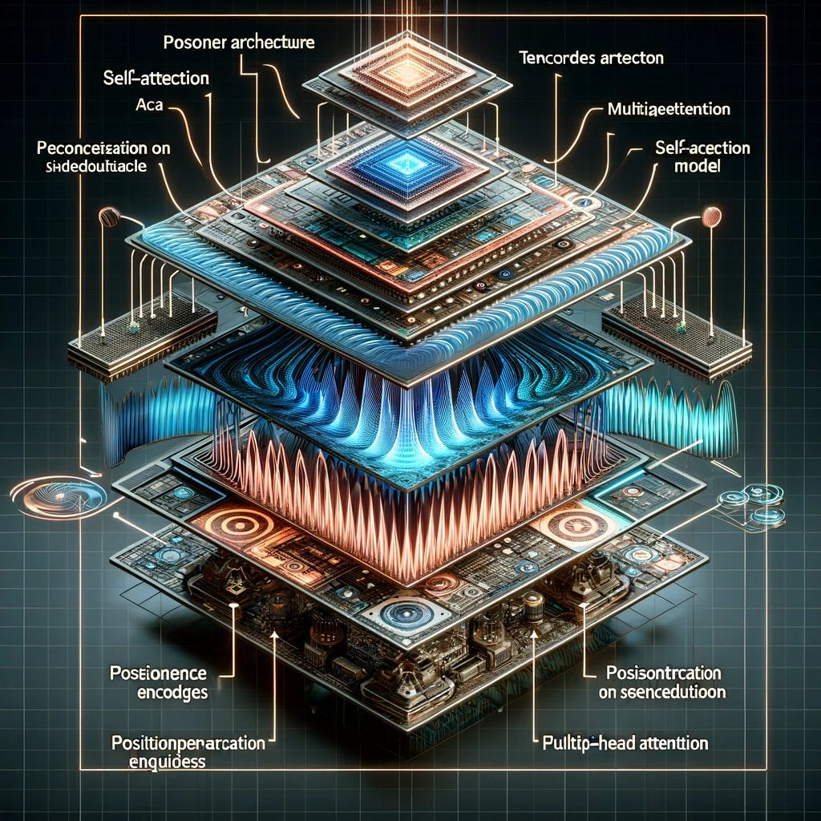
Artificial Neural Networks
Feedforward Neural Network (FNN) processes data in one direction, from Input to hidden to output nodes, using backpropagation to adjust weights and minimize prediction errors.
Convolutional Neural Network (CNN) analyzes structured grid data: image recognition, classification, and segmentation by learning spatial features.
Convolutional layers with filters apply activation functions for non-linearity, pooling layers to reduce dimensions, and fully connected layers for reasoning and prediction. Training through backpropagation.
Recurrent Neural Networks (RNNs) process sequential data and maintain memory.
Time series analysis, natural language processing, and speech recognition. RNNs update their hidden state at each time step to capture sequence information. Weight sharing across time steps helps with generalization. Training typically involves Backpropagation Through Time (BPTT).
Variants like Long-Short-Term Memory (LSTM) networks address the vanishing gradient problem, and Gated Recurrent Units (GRUs) provide computational efficiency.
Notes:
A Feedforward Neural Network (FNN) is a basic type of neural network. It processes data in one direction from input through any hidden nodes (if present) to output nodes, using backpropagation to adjust weights and minimize prediction errors.
A Convolutional Neural Network (CNN) is designed to analyze structured grid data, particularly images. It excels in tasks like image recognition, classification, and segmentation by learning spatial features. CNNs use convolutional layers with filters to create feature maps, apply activation functions for non-linearity, utilize pooling layers to reduce dimensions, and employ fully connected layers for high-level reasoning and predictions. Training is typically done through backpropagation to optimize the network's performance.
Recurrent Neural Networks (RNNs) are designed for processing sequential data and maintaining a memory of past inputs. This enables them to consider the order of data, making them well-suited for applications such as time series analysis, natural language processing, and speech recognition. RNNs update their hidden state at each time step to capture sequence information, and weight sharing across time steps helps with generalization. Training typically involves Backpropagation Through Time (BPTT) to manage temporal dependencies. Variants like Long Short-Term Memory (LSTM) networks and Gated Recurrent Units (GRUs) address the vanishing gradient problem, with LSTMs using gates for long-term information retention and GRUs providing computational efficiency. In medicine, RNNs are used to predict patient outcomes and analyze medical time series data.

Slide 15

Generative Artificial Intelligence
Generative artificial intelligence (GAI) creates new information by learning from existing data. It uses advanced machine learning models,
Generative Adversarial Networks (GANs) – ML frameworks that generate realistic new data by mimicking a training dataset through a competitive process
A generator creates samples and a discriminator evaluates them against real data, leading to high-quality, detailed outputs.
GANs are used in image generation, data augmentation, and the creation of realistic simulations and synthetic medical images.
Variational Autoencoders (VAEs) create new data learned from training data.
They learn to model the probability distribution of the input data.
They encode input data into a latent space and then decode it to generate new samples. This process often yields diverse samples, although they may lack the sharpness and realism typically found in GANs. Overall, VAEs are better for applications requiring diverse and interpretable data
Notes:
Generative artificial intelligence (GAI) is a type of AI that creates new content, data, or information by learning from existing data. It uses advanced machine learning models, including:
Generative Adversarial Networks (GANs) are machine learning frameworks that generate new, realistic synthetic instances of data by mimicking a training dataset through a competitive process between two neural networks: the generator and the discriminator. The generator creates samples, while the discriminator evaluates them against real data, leading to high-quality, detailed outputs. GANs are widely used in image generation, data augmentation, and the creation of realistic simulations, including synthetic medical images for healthcare applications,,
Variational Autoencoders (VAEs) are generative models in machine learning that create new data samples using a probabilistic approach. They learn the underlying distribution of a given dataset to model the probability distribution of the input data. They encode input data into a latent space and then decode it to generate new samples. This process often results in diverse samples, though they may lack the sharpness and realism found in samples generated by Generative Adversarial Networks (GANs). Overall, VAEs are better for applications requiring diverse and interpretable data, while GANs excel in generating high-quality, realistic outputs. Applications in healthcare include anomaly detection for diagnostics, synthetic medical images (e.g., MRI, CT scans) that can be used for training machine learning models, especially in scenarios where labeled data is scarce., data augmentation, predictive analysis and personalized medicine,

Slide 16
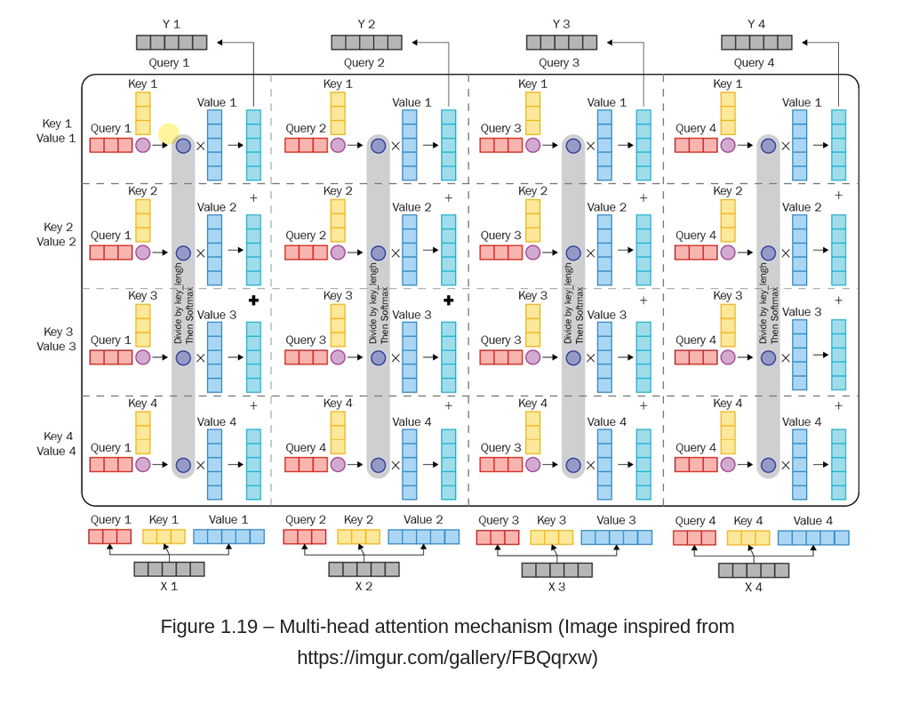
Generative Artificial Intelligence
Transformer models- neural network architecture used in natural language processing (NLP), computer vision, audio processing, and reinforcement learning.
Self-attention allows them to weigh the importance of different words in a sentence, regardless of their position. Highly effective at understanding context and relationships in data.
BERT (Bidirectional Encoder Representations from Transformers) and GPT (Generative Pre-trained Transformer) excel in tasks such as translation, summarization, and text generation.
Processing data in parallel also makes them faster and more efficient than previous sequential models, such as RNNs,
Transformer models are used for medical text analysis, drug discovery, medical imaging, predictive analysis, and virtual health assistants.
Notes:
Transformer models are a type of neural network architecture that has revolutionized natural language processing (NLP), computer vision, audio processing, and even reinforcement learning.
They rely on a mechanism called self-attention, which allows them to weigh the importance of different words in a sentence, regardless of their position. This makes them highly effective at understanding context and relationships in data.
Transformers are the foundation for many advanced models, such as BERT (Bidirectional Encoder Representations from Transformers) and GPT ( Generative Pre-trained Transformer), which excel in tasks like translation, summarization, and text generation. Their ability to process data in parallel also makes them faster and more efficient than previous sequential models like RNNs, enabling breakthroughs in AI applications across various domains.
In healthcare, transformer models are used for medical text analysis, drug discovery, medical imaging, predictive analysis, and virtual health assistants.

Slide 17
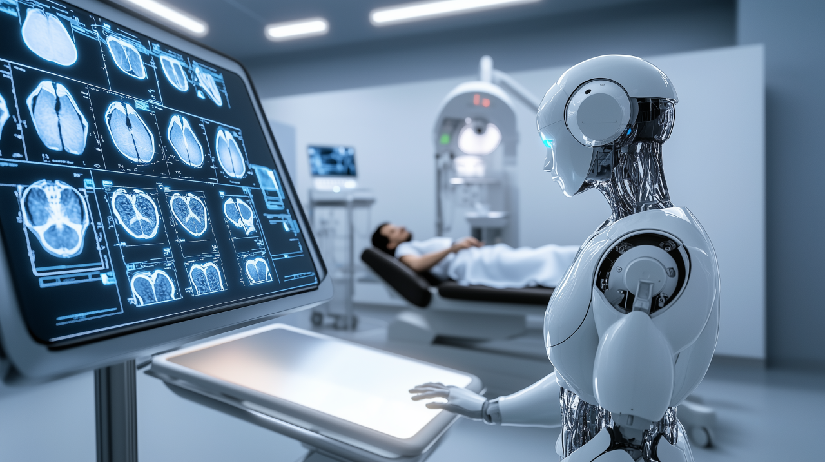
AI in Diagnostics
Deep learning (DL) models like convolutional neural networks (CNNs) are revolutionizing medical imaging by analyzing X-rays, MRIs, and CT scans to detect tumors and fractures, with high accuracy and speed, often matching or exceeding human performance.
GANs and VAEs- improve image recognition by reducing noise and artifacts,
Generate synthetic medical images to expand training datasets and ensure patient privacy
In 2018, DeepMind advanced the use of DL to analyze optical coherence tomography (OCT) scans for diagnosing diabetic retinopathy, age-related macular degeneration, and glaucoma.
The deep learning model demonstrated high diagnostic accuracy, often matching or exceeding the performance of expert ophthalmologists.
IDx-DR is an AI system designed for the early detection of diabetic retinopathy by analyzing retinal images. FDA approval in 2018 for clinical use without specialist interpretation.
The system uses a CNN, ideal for image analysis, to process retinal images and identify features of diabetic retinopathy, enabling accurate diagnoses without human intervention.
Improve patient outcomes, especially in settings with limited access to ophthalmologists.
Notes:
AI algorithms, particularly deep learning models (DL) like CNNs, are revolutionizing medical imaging by analyzing X-rays, MRIs, and CT scans to detect conditions like tumors and fractures, with high accuracy and speed, often matching or exceeding human performance
Generative Adversarial Networks (GANs) and Variational Autoencoders (VAEs), have improved image recognition by reducing noise and artifacts, aiding radiologists in accurate interpretations. AI also generates synthetic medical images to expand training datasets, ensuring patient privacy and confidentiality.
In 2018, DeepMind advanced AI in ophthalmology by utilizing deep learning (DL) to analyze optical coherence tomography (OCT) scans, enabling the accurate diagnosis of eye conditions such as diabetic retinopathy, age-related macular degeneration, and glaucoma. The deep learning model demonstrated high diagnostic accuracy, often matching or exceeding the performance of expert ophthalmologists.
IDx-DR is an AI system designed for the early detection of diabetic retinopathy by analyzing retinal images to identify signs of the disease. It received FDA approval in 2018 for clinical use without specialist interpretation, thereby enhancing the speed and efficiency of diagnosis. The system uses a convolutional neural network, ideal for image analysis, to process retinal images and identify features of diabetic retinopathy, enabling accurate diagnoses without human intervention.
IDx-DR can enable earlier detection and treatment of diabetic retinopathy, improving patient outcomes, especially in primary care settings with limited access to ophthalmologists.
Wu, C., Andaloussi, M. A., Hormuth, D. A., & et al. (2025). A critical assessment of artificial intelligence in magnetic resonance imaging of cancer. npj Imaging, 3 (15). https://doi.org/10.1038/s44303-025-00076-0
Hosny A, Parmar C, Quackenbush J, Schwartz LH, Aerts HJWL. Artificial intelligence in radiology. Nat Rev Cancer. 2018 Aug;18(8):500-510. doi: 10.1038/s41568-018-0016-5. PMID: 29777175; PMCID: PMC6268174.
Hosny, A., Parmar, C., Quackenbush, J., Schwartz, L. H., & Aerts, H. J. W. L. (2018). Artificial intelligence in radiology. Nature reviews. Cancer, 18(8), 500–510. https://doi.org/10.1038/s41568-018-0016-5
Pinto-Coelho L. (2023). How Artificial Intelligence Is Shaping Medical Imaging Technology: A Survey of Innovations and Applications. Bioengineering (Basel, Switzerland), 10(12), 1435. https://doi.org/10.3390/bioengineering10121435
Mall, P. K., Singh, P. K., Srivastav, S., Narayan, V., Paprzycki, M., Jaworska, T., & Ganzha, M. (2023). A comprehensive review of deep neural networks for medical image processing: Recent developments and future opportunities. Healthcare Analytics, 4, 100216. https://doi.org/10.1016/j.health.2023.100216
Li, M., Jiang, Y., Zhang, Y., & Zhu, H. (2023). Medical image analysis using deep learning algorithms. Frontiers in public health, 11, 1273253. https://doi.org/10.3389/fpubh.2023.1273253

Slide 18

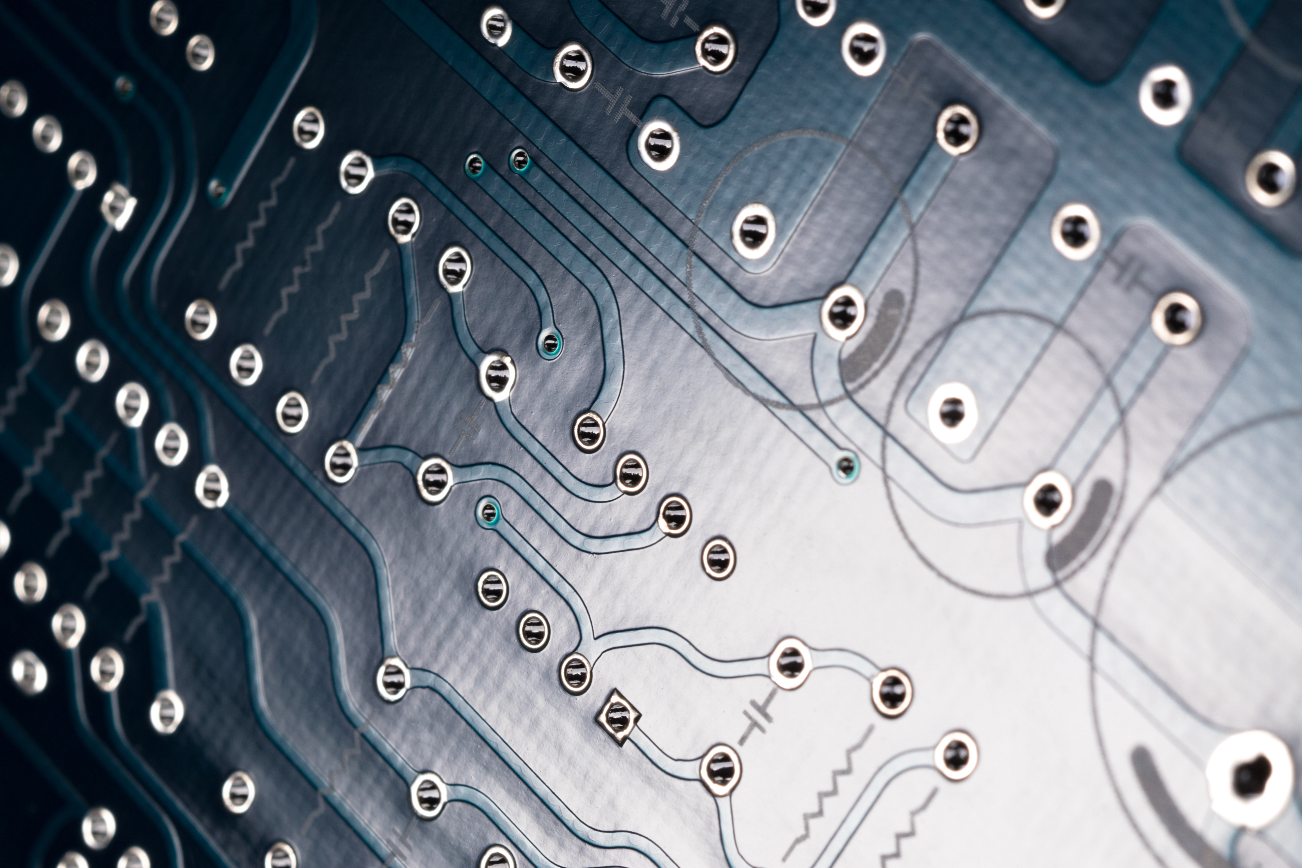

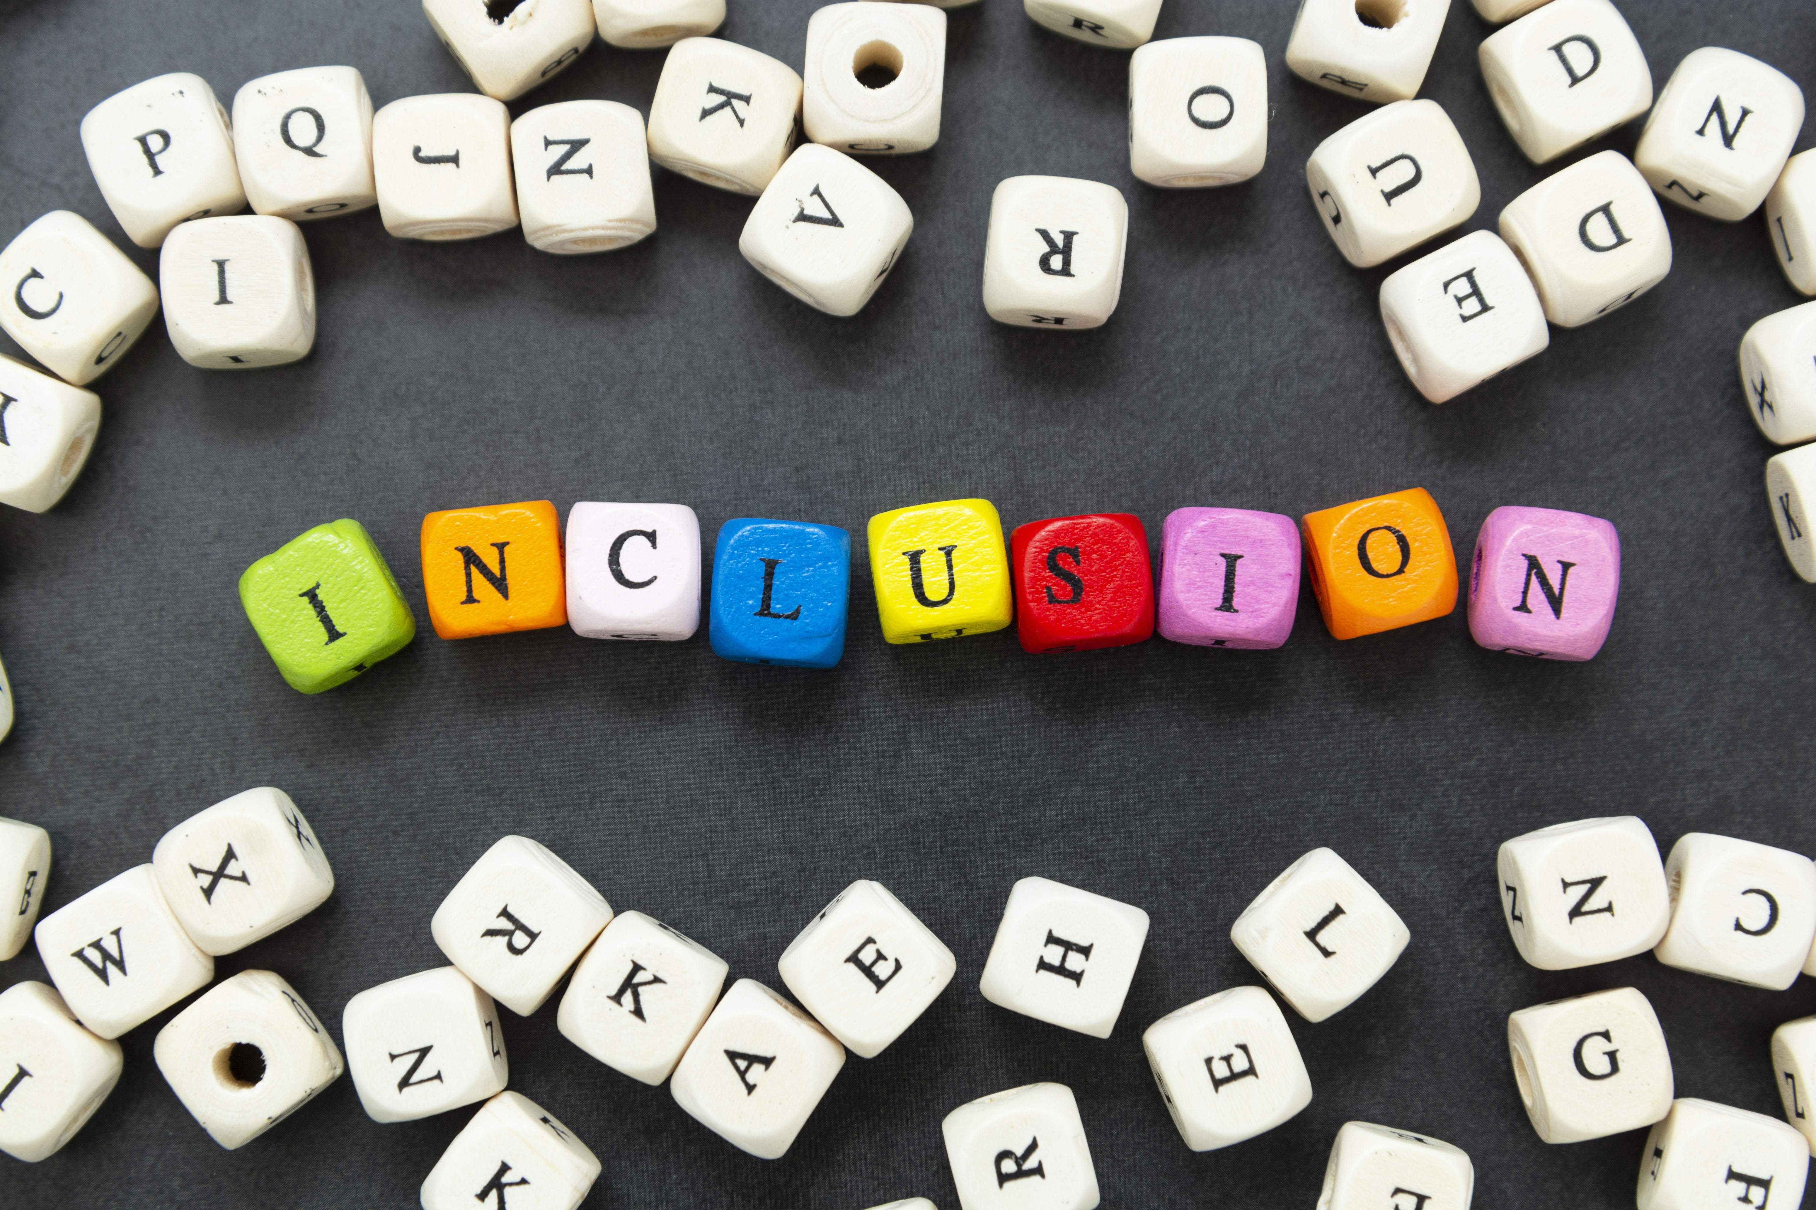
AI and Predictive Analytics in Medicine
AI models can analyze patient data to predict disease progression, readmission rates, and potential complications.
Recurrent Neural Networks (RNNs) process sequential data. Make predictions on time series like disease progression, or readmission rates. Long Short-Term Memory Networks (LSTMs) capture long-term
Convolutional Neural Networks (CNNs) structured data when spatial hierarchies are relevant. Extract hierarchical features for predictive modeling. Identifying complex relationships within data
Feedforward Neural Networks (FNNs) are employed for straightforward prediction tasks with direct relationships between input features and outcomes.
Transformer models efficiently manage complex dependencies and large datasets.
Notes:
AI models can analyze patient data to predict outcomes such as disease progression, readmission rates, and potential complications. This predictive capability aids in proactive patient management and the development of personalized treatment plans. Several types of neural networks are commonly used for predictive analytics and decision support in healthcare.
Recurrent Neural Networks (RNNs) are effective for processing sequential data and making predictions on time series, making them suitable for analyzing patient data over time to forecast disease progression or readmission rates. Long Short-Term Memory Networks (LSTMs), a type of Recurrent Neural Network (RNN), excel at capturing long-term dependencies in patient data.
Convolutional Neural Networks (CNNs), primarily utilized for image analysis, can also be adapted for structured data when spatial hierarchies are relevant. CNNs effectively extract important features hierarchically from data, enhancing predictive modeling. This ability can be advantageous for identifying complex relationships within patient data that may not be immediately apparent.
Feedforward Neural Networks (FNNs) are employed for straightforward prediction tasks with direct relationships between input features and outcomes.
Transformer models are gaining traction in healthcare for their ability to manage complex dependencies and large datasets efficiently.
By examining historical data and current patient information, AI helps healthcare providers make proactive decisions to improve patient care and address potential health risks.

Slide 19
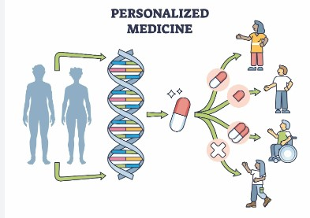
AI and Personalized Medicine
AI utilizes machine learning (ML) techniques, such as convolutional neural networks (CNN) and natural language processing (NLP), to develop personalized treatment plans that incorporate genetic profiles, medical histories, and lifestyle factors
AI enhances diagnosis by analyzing medical images and lab results, identifying patterns to improve accuracy By examining large datasets. AI tailors therapies to individual patients
Watson for Genomics (WfG) utilizes precision oncology to analyze tumor genomic data, identifying cancer-driving mutations and providing oncologists with tailored, evidence-based treatment options.
Watson for Oncology (WfO) integrates patient data with medical literature for informed treatment recommendations.
Notes:
AI utilizes machine learning techniques, such as CNN and NLP, to develop personalized treatment plans that incorporate genetic profiles, medical histories, and lifestyle factors.
These systems enhance disease diagnosis by analyzing medical images and lab results, identifying patterns to improve accuracy. By examining large datasets, AI effectively tailors therapies to individual patients.
Watson for Genomics (WfG) utilizes precision oncology to analyze tumor genomic data, identifying cancer-driving mutations and providing oncologists with tailored, evidence-based treatment options.
Watson for Oncology (WfO) integrates patient data with medical literature for informed treatment recommendations.

Slide 20
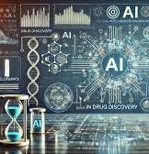
AI in Drug Discovery and Development
DL techniques like GANs and VAEs play a pivotal role in molecular generation for drug discovery.
Expedite the identification and optimization of drug candidates. Additionally, AI simulates compound-target interactions.
In 2020, DeepMind launched AlphaFold 2, utilizing deep learning (DL) techniques to predict protein folding by analyzing biological data and known protein structures.
In the 14th Critical Assessment of protein Structure Prediction (CASP14) competition, AlphaFold 2 outperformed all other computational methods with accuracy comparable to X-ray crystallography and nuclear magnetic resonance (NMR).
Technologies like AlphaFold 2 are aiding drug discovery and biotechnology, facilitating the novel synthesis of proteins for antivenoms, anti-inflammatory drugs, cancer treatments, and vaccines.
InstaNovo is an AI model that employs transformer architecture for de novo peptide sequencing.
It analyzes mass spectrometry data to construct amino acid sequences, thereby enhancing therapeutic coverage and exploring the "dark proteome."
Notes:
Generative deep learning (DL) techniques, such as generative adversarial networks (GANs) and variational autoencoders (VAEs), play a pivotal role in molecular generation for drug discovery. They expedite the identification and optimization of drug candidates by predicting chemical properties, biological activity, efficacy, and safety, thus reducing the time and cost associated with bringing new drugs to market. Additionally, AI simulates compound-target interactions.
In 2020, DeepMind launched AlphaFold 2, utilizing advanced deep learning and neural networks, such as transformers, to predict protein folding by analyzing biological data and known structures. In the 14th Critical Assessment of protein Structure Prediction (CASP14) competition, AlphaFold 2 outperformed all other computational methods with accuracy comparable to experimental techniques like X-ray crystallography and nuclear magnetic resonance (NMR).
Its accuracy holds significant implications for drug discovery and biotechnology, assisting in novel protein synthesis for antivenom, anti-inflammatory drugs, cancer treatments, and vaccine development.
InstaNovo is an AI model that employs transformer architecture for de novo peptide sequencing. It analyzes mass spectrometry data to construct amino acid sequences, enhancing therapeutic coverage and exploring the "dark proteome," regions of the proteome that are not well understood or characterized.

Slide 21
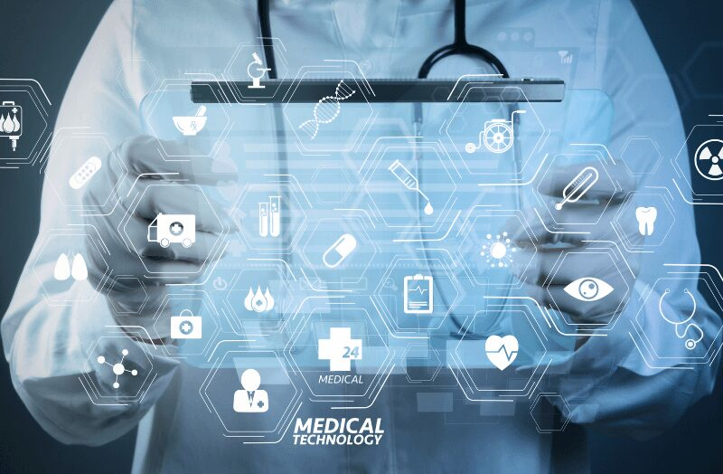
Clinical Decision Support Systems(CDSS)
Artificial intelligence (AI) and decision support systems enhance healthcare by improving diagnosis and treatment through data-driven analysis. This leads to timely diagnoses, better patient outcomes, and personalized treatment plans, especially with the use of predictive analytics.
AI expert systems offer data-driven insights, providing evidence-based recommendations during consultations.
AI enhances clinical decision support systems (CDSS) in hospital operations by predicting patient admissions, managing staff schedules, and optimizing resource allocation.
AI plays a crucial role in patient monitoring and management by continuously analyzing patient data, such as vital signs, and alerting providers to significant changes.
AI-supported decision systems accelerate research and drug development, expediting the discovery of new treatments.
Notes:
Artificial intelligence (AI) and decision support systems enhance healthcare by improving diagnosis and treatment through data-driven analysis. This leads to timely diagnoses, better patient outcomes, and personalized treatment plans, especially with the use of predictive analytics.
AI expert systems offer data-driven insights, providing evidence-based recommendations during consultations.
AI enhances clinical decision support systems (CDSS) in hospital operations by predicting patient admissions, managing staff schedules, and optimizing resource allocation.
AI plays a crucial role in patient monitoring and management by continuously analyzing patient data, such as vital signs, and alerting providers to significant changes.
AI-supported decision systems accelerate research and drug development, expediting the discovery of new treatments.

Slide 22
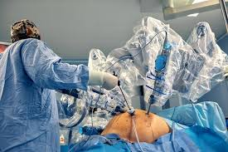
Robotics and Surgery
AI-powered robotic systems enhance surgical precision and assist surgeons and proceduralists, such as gastroenterologists, in complex procedures.
The Da Vinci Surgical System was approved by the FDA in 2000.
Improved surgical precision and control. It merges the surgeon's expertise with real-time data analysis to enhance patient outcomes.
Filters out hand tremors, enabling delicate maneuvers. Their dexterous instruments can rotate and bend beyond human capability.
Results in smaller incisions, reduced pain, less scarring, and quicker recovery, in procedures like prostatectomies, hysterectomies, and cardiac surgeries.
Many robotic systems offer high-definition, 3D visualization of surgical sites, enhancing surgeons' accuracy.
Notes:
AI-powered robotic systems enhance surgical precision and assist surgeons and proceduralists, such as gastroenterologists, in complex procedures.
The Da Vinci Surgical System, approved by the FDA in 2000, revolutionized medicine through robotic-assisted surgery, improving surgical precision and control. It merges the surgeon's expertise with real-time data analysis to enhance patient outcomes.
Robotic systems enhance surgical precision by filtering out hand tremors, enabling delicate maneuvers. Their dexterous instruments can rotate and bend beyond human capability, providing access to hard-to-reach areas for complex procedures.
They facilitate minimally invasive operations, resulting in smaller incisions, reduced pain, less scarring, and quicker recovery, benefiting procedures like prostatectomies, hysterectomies, and cardiac surgeries
Many robotic systems offer high-definition, 3D visualization of surgical sites, enhancing surgeons' accuracy.
.

Slide 23
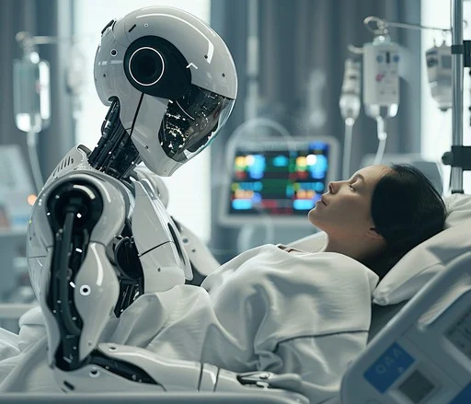
AI and Robotics
Some robotic systems enable telesurgery, allowing surgeons to perform procedures remotely.
Provides access to specialized surgical care in remote or underserved areas.
Systems often include simulation capabilities that enable surgeons to practice and refine their skills in a virtual environment.
The humanoid robot, dubbed BroBot by RobotLAB, can function in dynamic and unpredictable hospital environments.
It features a hybrid analog-digital interface, autonomous task protocols, and situational awareness systems to carry out essential duties with minimal supervision.
Notes:
Some robotic systems enable telesurgery, allowing surgeons to perform procedures remotely. This can be especially useful for providing access to specialized surgical care in remote or underserved areas.
These systems often include simulation capabilities that allow surgeons to practice and refine their skills in a virtual environment, enhancing their proficiency and confidence before actual surgical procedures.
Beyond the operating room, a humanoid robot, dubbed BroBot by RobotLAB, has been developed to function in dynamic and unpredictable hospital environments. It features a hybrid analog-digital interface, autonomous task protocols, and situational awareness systems to carry out essential duties with minimal supervision.

Slide 24

AI Streamlines Administrative Tasks
AI streamlines administrative processes, such as scheduling, billing, and managing electronic health records (EHRs).
AI reduces the administrative burden and improves accuracy and efficiency.
AI-powered chatbots and virtual assistants manage routine inquiries, schedule appointments, and offer basic medical advice.
Automated report generation with Transformer models allows for the creation of clinical reports and documentation that summarize patient data and generate narratives.
These models use Natural Language Processing (NLP) to analyze unstructured clinical notes and transform them into structured data.
Notes:
AI streamlines administrative processes, such as scheduling, billing, and managing electronic health records (EHRs.
AI reduces the administrative burden and improves accuracy and efficiency.
AI-powered chatbots and virtual assistants manage routine inquiries, schedule appointments, and offer basic medical advice, enabling healthcare professionals to focus on more complex cases.
Automated report generation with Transformer models allows for the creation of clinical reports and documentation by summarizing patient data and generating narratives, thus decreasing healthcare providers' workload.
These models use Natural Language Processing (NLP) to analyze unstructured clinical notes and transform them into structured data, which improves the accuracy of Electronic Health Records (EHRs).

Slide 25
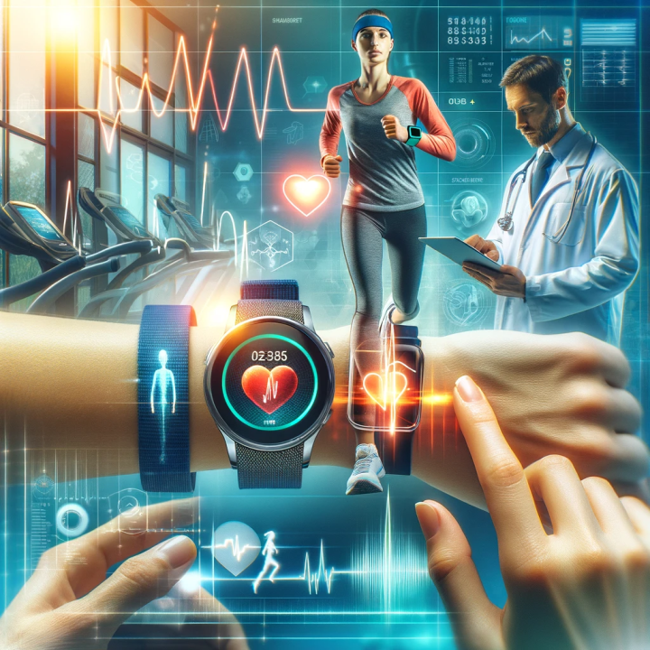
Remote Monitoring
AI algorithms analyze data from wearable devices in real time. Wearable devices offer cost-effective, non-invasive, and scalable health monitoring solutions.
Wearable sensors monitor heart rate, blood pressure, oxygen saturation, sleep patterns, and biochemical markers. This technology ranges from fitness trackers to advanced sensors. Sensors can be :
physical and physiological, like activity trackers and smartwatches;
chemical/biosensors (which analyze sweat, tears, saliva, and interstitial fluid);
electrophysiological sensors, and optical sensors.
ML algorithms trained with supervised and unsupervised learning techniques utilize neural networks such as Convolutional Neural Networks (CNNs) and Recurrent Neural Networks (RNNs) with Long Short-Term Memory (LSTM) to analyze real-time data from remote monitoring and identify patterns.
These AI models help healthcare providers predict disease progression and make informed decisions about patient care.
Notes:
AI algorithms analyze data from wearable devices to track health metrics in real time. Flexible electronics in wearable devices offer cost-effective, non-invasive, and scalable health monitoring solutions.
Wearable sensors monitor heart rate, blood pressure, oxygen saturation, sleep patterns, and biochemical markers. This technology ranges from fitness trackers to advanced sensors.
Sensors can be :
physical and physiological, like activity trackers and smartwatches;
chemical/biosensors (which analyze sweat, tears, saliva, and interstitial fluid);
electrophysiological sensors, and optical sensors.
Machine learning algorithms, trained with supervised and unsupervised learning techniques, utilize neural networks such as Convolutional Neural Networks (CNNs) and Recurrent Neural Networks (RNNs) with Long Short-Term Memory (LSTM) to analyze real-time data from remote monitoring and identify patterns.
These AI models help healthcare providers predict disease progression and make informed decisions about patient care.

Slide 26
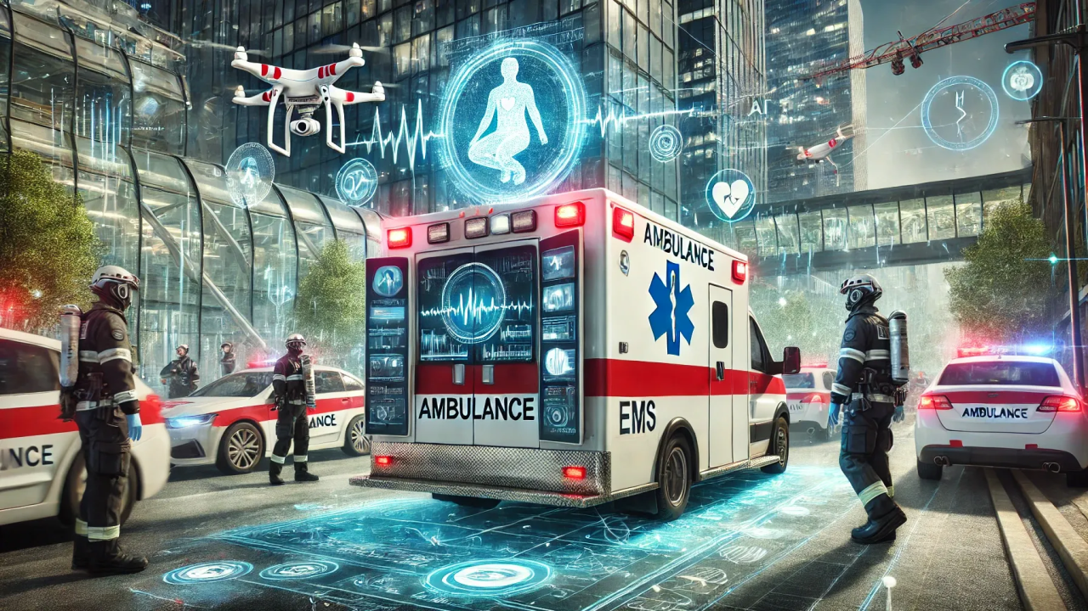
AI Improves Public Health Emergency Operations
AI processes diverse data to detect early signs of outbreaks and track the spread of diseases.
AI provides insights into patterns of human behavior, enabling the development of customized interventions.
AI enhances contact tracing by quickly identifying exposed individuals. It streamlines the distribution of medical supplies and supports decision-makers
In recovery, AI can share accurate information to counter misinformation and guide public behavior.
AI accelerates vaccine and drug development by analyzing biological data to identify potential candidates and predict their efficacy.
AI has improved Public Health Emergency Operations Centers (PHOEC) by enhancing management across the preparedness, response, and recovery stages.
Notes:
AI has significantly improved Public Health Emergency Operations Centers (PHOEC) by enhancing management across the preparedness, response, and recovery stages.
It analyzes past data to predict emergencies, ensuring readiness, and processes diverse data sources to detect early signs of outbreaks and track disease spread, enabling timely interventions and effective public health responses.
AI offers insights into patterns of human behavior, facilitating the creation of customized interventions to improve compliance with public health measures.
During emergencies, AI improves contact tracing by swiftly identifying exposed individuals, optimizes the distribution of medical supplies, and assists decision-makers with integrated information, enhancing understanding and facilitating rapid, evidence-based actions for effective responses.
In recovery, AI can share accurate information to counter misinformation and guide public behavior.
AI accelerates vaccine and drug development by analyzing biological data to identify potential candidates and predict their efficacy.

Slide 27
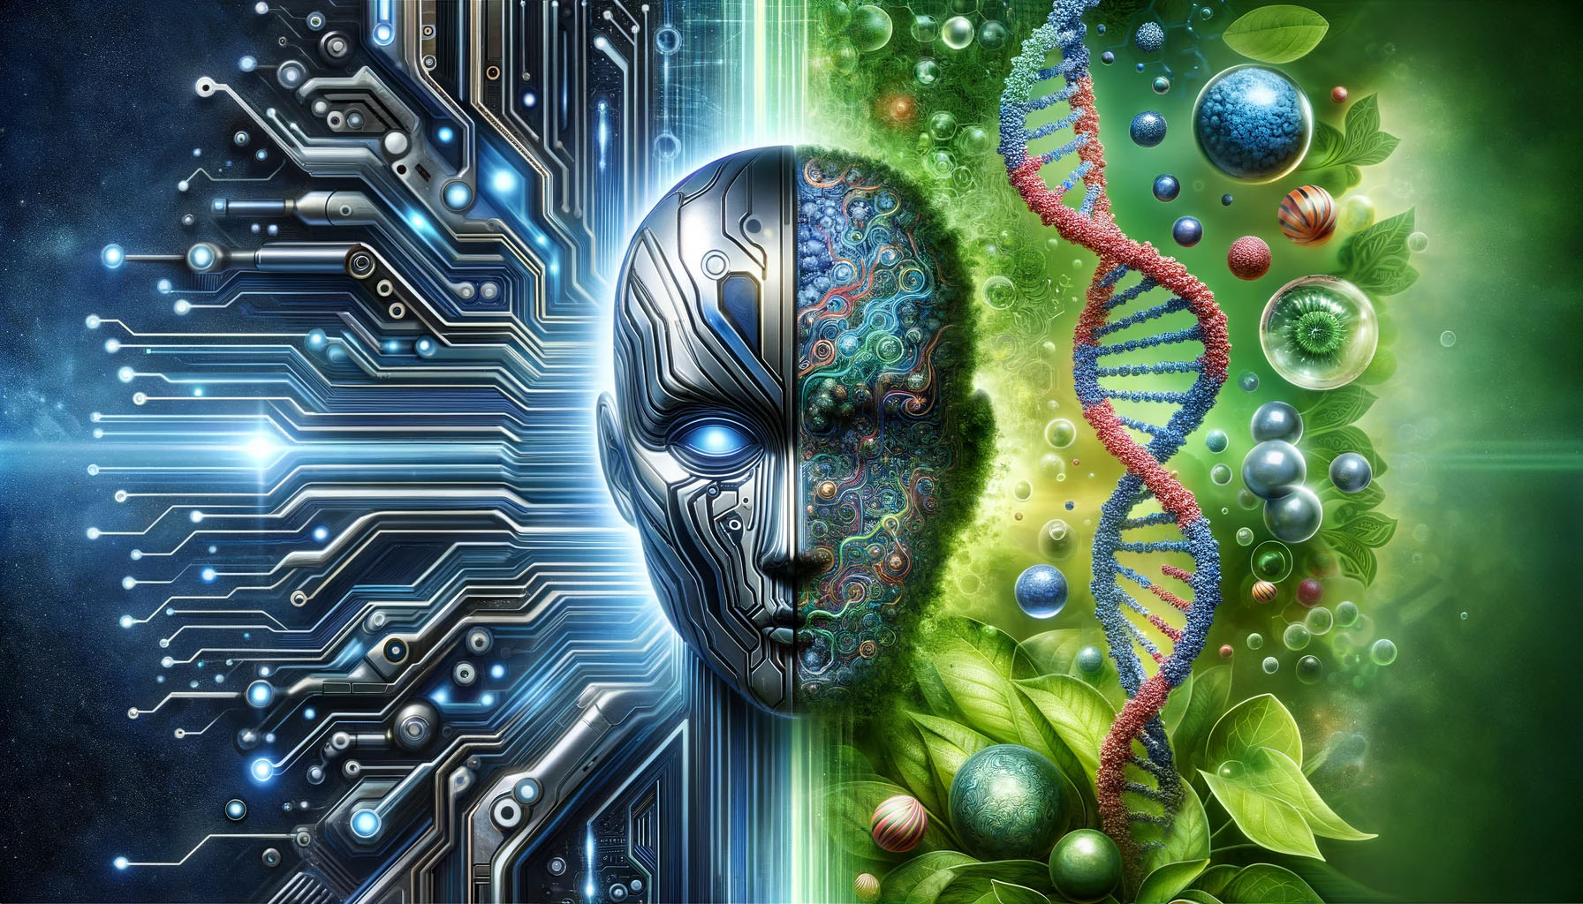
Synthetic Biology
Artificial intelligence (AI), particularly through deep learning, enhances synthetic biology by improving research design and development.
AI accelerates research by automating data analysis and experimentation,
AI automates the design of genetic circuits and metabolic pathways
AI improves the design and optimization of proteins
AI assists in DNA synthesis, streamlining genome creation
Notes:
Artificial intelligence (AI), particularly through deep learning, significantly enhances synthetic biology by improving research design and development.
AI accelerates research by automating data analysis and experimentation, analyzing extensive datasets, and augmenting researchers' ability to predict how systems perform under various conditions. This aids in more precise engineering, predicting engineered cell behavior, and designing personalized therapeutic strategies.
AI automates the design of genetic circuits and metabolic pathways, systematically optimizing genetic components for specific functions, such as compound production or environmental response.
AI improves the design and optimization of proteins by improving the prediction of their structures and functions based on sequence data. This capability facilitates the creation of new enzymes or therapeutic proteins and identifies efficient pathways for compound production, optimizing resource use and minimizing byproducts.
AI assists in DNA synthesis, streamlining genome creation, and evaluates risks and ethics through outcome simulations in synthetic biology projects.

Slide 28
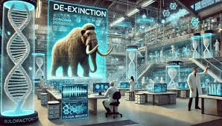
Synthetic Biology
AI-driven robotics can automate laboratory experiments.
AI’s synergy with CRISPR-Cas9 broadens applications in synthetic biology,
AI can speed up drug discovery by analyzing genomic data.
AI assists in managing and analyzing genetic part databases
AI encourages collaboration among researchers, thereby accelerating technological advancements in the field.
Notes:
AI-driven robotics will automate laboratory experiments, increasing throughput and reducing errors while adapting to real-time conditions.
The integration of AI and CRISPR (Clustered Regularly Interspaced Short Palindromic Repeats) is revolutionizing genetic research by predicting effective guide RNAs and enhancing the precision of gene editing. AI identifies optimal targets, minimizes off-target effects, and designs effective guide RNAs (gRNAs), ensuring that CRISPR applications are safer and more accurate. Its synergy with CRISPR-Cas9 broadens applications in synthetic biology, drug discovery, and personalized medicine. This, however, raises concerns about ethics and safety.
AI can speed up drug discovery by analyzing genomic data to identify gene clusters that produce natural products. It also models metabolic pathways to discover bottlenecks, enabling redesigns that enhance the production of biofuels and pharmaceuticals.
AI assists in managing and analyzing genetic part databases, facilitating the selection of optimal components for synthetic circuits.
AI encourages collaboration among researchers, thereby accelerating technological advancements in the field.

Slide 29
Benefits of AI in Medicine
AI enhances diagnostics, personalizes treatment, improves efficiency, boosts patient outcomes, reduces cost, and accelerates drug discovery.
AI enhances diagnostic accuracy by minimizing human error.
AI enhances efficiency by automating routine administrative tasks, such as scheduling appointments and managing patient records.
AI enhances patient outcomes by using genetic information and medical history to create personalized treatment plans, predict health outcomes …
AI accelerates the drug discovery process by analyzing biological data and predicting how different compounds will interact with diseases
AI reduces costs for providers and patients by boosting healthcare efficiency and accuracy, increasing accessibility, optimizing resources, minimizing procedures, and enhancing telemedicine.
Notes:
AI enhances diagnostics, personalizes treatment, improves efficiency, boosts patient outcomes, reduces cost, and accelerates drug discovery. As its role in healthcare expands, it brings even more benefits to patients and providers.
AI enhances diagnostic accuracy by minimizing human error, rapidly analyzing medical images to identify health issues and provide evidence-based recommendations for informed clinical decisions.
AI enhances efficiency by automating routine administrative tasks, such as scheduling appointments and managing patient records, allowing healthcare professionals to concentrate more on patient care.
AI enhances patient outcomes by using genetic information and medical history to create personalized treatment plans, predict health outcomes, identify at-risk individuals, and engage patients for better adherence and overall health.
AI accelerates the drug discovery process by analyzing biological data and predicting how different compounds will interact with diseases, leading to faster development of new medications.
AI reduces costs for providers and patients by boosting healthcare efficiency and accuracy, increasing accessibility, optimizing resources, minimizing procedures, and enhancing telemedicine.

Slide 30
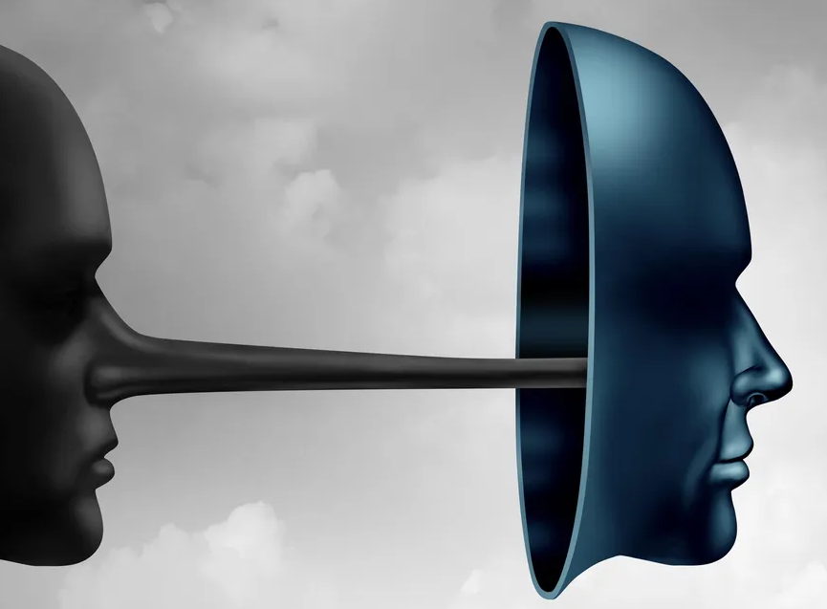
Challenges: transparency, accountability, and biases
Many AI models, particularly deep learning algorithms, operate as "black boxes," complicating transparency.
Explainable AI (XAI) is essential for fostering trust and understanding in critical fields like healthcare and criminal justice.
As AI systems gain autonomy, it is vital to maintain human control over critical decisions, requiring clear guidelines for intervention. This also involves addressing the complexities of accountability regarding responsibility for AI actions among developers, users, and the AI itself.
AI algorithms can perpetuate biases inherent in training data, resulting in unfair treatment based on factors such as race, gender, or socioeconomic status.
Ensuring fairness requires careful data selection and algorithm design to prevent disparities in healthcare delivery.
Notes:
Many AI models, particularly deep learning algorithms, function as "black boxes," complicating decision transparency. Developing Explainable AI (XAI) is essential for fostering trust and understanding in critical fields like healthcare and criminal justice.
As AI systems gain autonomy, it is vital to maintain human control over critical decisions, requiring clear guidelines for intervention. This also involves addressing the complexities of accountability regarding responsibility for AI actions among developers, users, and the AI itself.
AI algorithms can perpetuate biases inherent in training data, resulting in unfair treatment based on factors such as race, gender, or socioeconomic status. Ensuring fairness requires careful data selection and algorithm design to prevent disparities in healthcare delivery.

Slide 31

Challenges: Privacy and Security
Ensuring patient data privacy and security is crucial for AI systems, which must comply with regulations like HIPAA while addressing risks of harm, misuse, and manipulation that can arise from deepfakes, autonomous weapons, or cyberattacks.
The February 2024 BlackCat/ALPHV ransomware attack on Change Healthcare disrupted healthcare commerce, exposed the personal health information (PHI) of 190 million individuals, and led to a $22 million ransom payment. Healthcare breaches in the US increased by 64.1% in 2024, affecting 277 million records.
The May 2017 WannaCry ransomware attack impacted hundreds of thousands of computers worldwide, encrypting files and demanding ransom payments in Bitcoin. By exploiting the EternalBlue vulnerability, it severely affected organizations, notably the UK's NHS, leading to canceled appointments and disrupted services.
Notes:
Ensuring patient data privacy and security is crucial for AI systems, which must comply with regulations like HIPAA while addressing risks of harm, misuse, and manipulation that can arise from deepfakes, autonomous weapons, or cyberattacks.
The February 2024 BlackCat/ALPHV ransomware attack on Change Healthcare disrupted healthcare commerce, exposed the personal health information (PHI) of 190 million individuals, and led to a $22 million ransom payment. Healthcare breaches in the US increased by 64.1% in 2024, affecting 277 million records, 81% of the population.
The May 2017 WannaCry ransomware attack impacted hundreds of thousands of computers worldwide, encrypting files and demanding ransom payments in Bitcoin. By exploiting the EternalBlue vulnerability, it severely affected organizations, notably the UK's NHS, leading to canceled appointments and disrupted services.

Slide 32
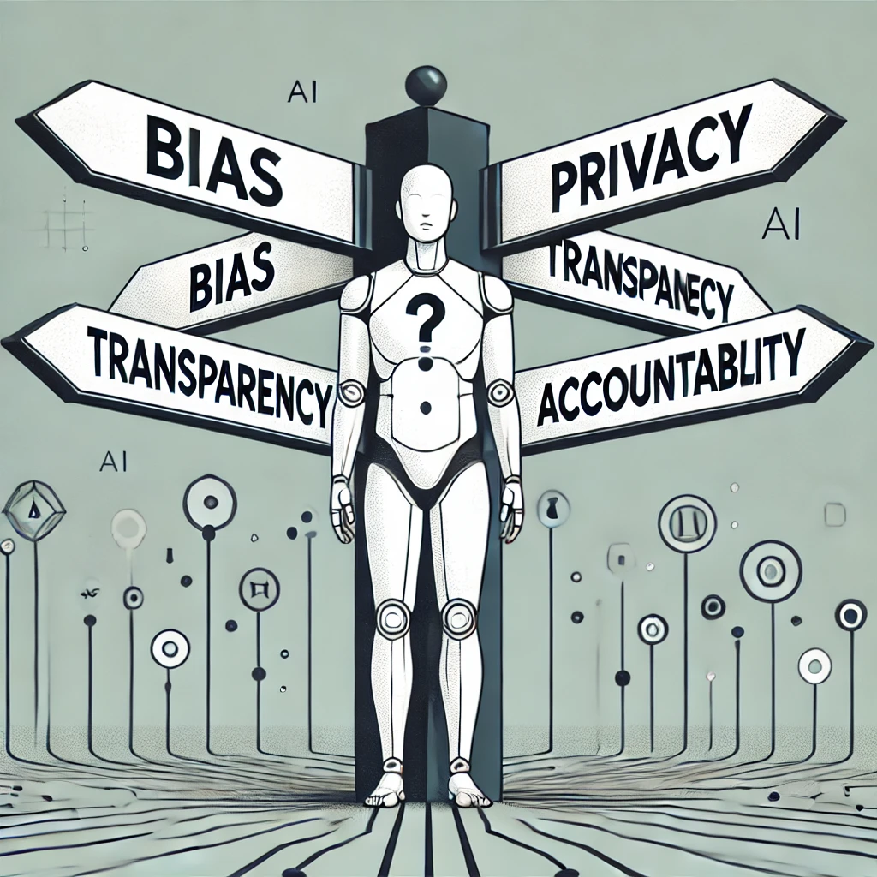
Challenges: Discrimination
Discrimination in AI applications, such as hiring, law enforcement, and lending, can perpetuate existing inequalities if not correctly managed. It is essential to implement measures that promote equity and prevent discrimination.
The rise of AI and automation may lead to job displacement. Ethical considerations include how to support affected workers and ensure a just transition.
The development of superintelligent AI poses existential risks and ethical dilemmas regarding control and alignment with human values. Similarly, gene editing technologies like CRISPR-Cas9 raise debates about enhancing human cognitive abilities and creating "superhuman" species.
Gene editing could be used to enhance physical traits such as strength, endurance, or speed by altering genes associated with muscle growth or metabolism. This could lead to “gene doping” among athletes.
Notes:
Discrimination in AI applications, such as hiring, law enforcement, and lending, can perpetuate existing inequalities if not correctly managed. It is essential to implement measures that promote equity and prevent discrimination.
The rise of AI and automation may lead to job displacement. Ethical considerations include how to support affected workers and ensure a just transition.
The development of superintelligent AI poses existential risks and ethical dilemmas regarding control and alignment with human values. Similarly, gene editing technologies like CRISPR-Cas9 raise debates about enhancing human cognitive abilities and creating "superhuman" species.
Theoretically, gene editing could be used to enhance physical traits such as strength, endurance, or speed by altering genes associated with muscle growth or metabolism. This could lead to “gene doping” among athletes.

Slide 33

Challenges: Hallucinations
Hallucination occurs when AI generates incorrect or fabricated information and presents it as factual.
This creates challenges for patient safety,
Hallucinations arise from biases or gaps in the training data.
Frequent hallucinations can erode healthcare professionals' trust in AI.
Misleading information complicates provider-patient communication,
Hallucinations raise complex liability questions in healthcare when erroneous AI information harms patients
Who is responsible: developers, providers, institutions?
Therefore, regulatory bodies must establish guidelines to ensure AI's safety.
Notes:
Hallucination occurs when AI generates incorrect or fabricated information and presents it as factual. In medicine, this creates challenges for patient safety, leading to incorrect diagnoses, inappropriate treatments, and potential harm, including adverse drug reactions or delays in care.
Hallucinations in AI systems often arise from biases or gaps in the training data. While training on diverse, high-quality datasets is crucial, the complexity of medical knowledge complicates the consistent accuracy and context understanding in AI outputs.
Frequent hallucinations can erode healthcare professionals' trust in AI, leading to reluctance to use these tools and undermining their benefits. Misleading information complicates provider-patient communication, fostering confusion and uncertainty during critical decision-making.
Hallucinations raise complex liability questions in healthcare when erroneous AI information harms patients, complicating responsibility among developers, providers, and institutions. Therefore, regulatory bodies must establish guidelines to ensure AI's safety and efficacy amid rapid technological evolution.

Slide 34
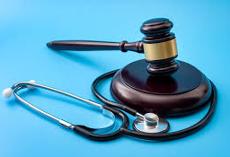
Regulatory Approval
AI medical technologies must undergo thorough testing, validation, and obtain approval from regulatory bodies to ensure safety and efficacy before being implemented in clinical settings.
Ethical guidelines for the development and deployment of AI are crucial.
The EU AI Act of 2024 proposes regulations to ensure AI safety, respect for rights, and trustworthiness. It outlines the compliance requirements for providers and users, with national authorities responsible for enforcement and penalizing non-compliance.
The U.S. lacks comprehensive federal AI regulation; however, state-level initiatives, like New York's 80+ bills focused on AI transparency and usage limitations, are advancing, with some already enacted or under consideration.
The seamless integration of AI tools into existing healthcare systems and clinical workflows is vital for maximizing their utility and ensuring successful adoption.
Notes:
AI technologies in medicine must undergo rigorous testing and validation and get approval from regulatory bodies to ensure safety and efficacy before being implemented in clinical settings.
Establishing ethical guidelines and regulatory frameworks for AI development and deployment is essential to ensure that technology serves the public good and aligns with societal values.
The EU AI Act in 2024 proposes regulations ensuring AI safety, rights respect, and trustworthiness, outlining compliance for providers and users, with national authorities enforcing and fining non-compliance.
The U.S. lacks comprehensive federal AI regulation, but state-level initiatives, like New York's 80+ bills on AI transparency and use limitations, are in progress, with some enacted or pending.
Integration into Clinical Workflows
Seamless integration of AI tools into existing healthcare systems and clinical workflows is essential for maximizing their utility and successful adoption.

Slide 35
Collaboration
Collaboration is essential for developing effective AI solutions. International dialogue on AI safety and ethics is crucial for harnessing the benefits of AI while mitigating risks and promoting a safe and equitable future worldwide.
The Bletchley Declaration, AI Safety Summit 2023, commits countries to the safe development of AI, emphasizing the importance of ethical development, transparency, and accountability. It urges international collaboration, increased research investment, and robust regulations
The General Data Protection Regulation (GDPR), May 25, 2018, safeguards individuals' privacy and personal data within the EU. It establishes principles for data processing and grants rights such as access, rectification, and erasure. Organizations must obtain consent and report breaches within 72 hours, facing fines for non-compliance.
Notes:
Collaboration among AI researchers, clinicians, and healthcare professionals is essential for developing effective AI solutions, ensuring a shared understanding and unified efforts. International dialogue on AI safety and ethics is crucial for harnessing the benefits of AI while mitigating risks, promoting a safe and equitable future worldwide.
The Bletchley Declaration, established during the AI Safety Summit on November 1-2, 2023, commits countries to the safe development of AI, emphasizing the importance of ethical development, transparency, and accountability. It urges international collaboration, increased research investment, and robust regulations to ensure that AI benefits society while minimizing risks.
The General Data Protection Regulation (GDPR), which took effect on May 25, 2018, safeguards individuals' privacy and personal data within the EU. It establishes principles for data processing and grants rights such as access, rectification, and erasure. Organizations must obtain consent and report breaches within 72 hours, facing fines for non-compliance.

Slide 36

Future Directions and Conclusion
The future of AI in medicine holds tremendous promise as it becomes a transformative force in care delivery, significantly enhancing patient outcomes and improving quality of life.
By leveraging adaptive learning, artificial intelligence can improve diagnostic accuracy, ensuring patients receive effective care. It can also provide personalized health support tailored to individual needs. It can accelerate drug development, transform medical education, and play a crucial role in pandemic response.
However, addressing ethical and regulatory challenges is essential for the successful implementation and prevention of negative consequences.
The ideal future envisions a partnership where humans and advanced AI systems collaborate to enhance creativity and efficiency, yielding remarkable outcomes for healthcare.
Notes:
The future of AI in medicine holds tremendous promise as it becomes a transformative force in care delivery, significantly enhancing patient outcomes and improving quality of life.
By leveraging adaptive learning, artificial intelligence can improve diagnostic accuracy, ensuring patients receive effective care. It can also provide personalized health support tailored to individual needs. It can accelerate drug development, transform medical education, and play a crucial role in pandemic response.
However, addressing ethical and regulatory challenges is essential for the successful implementation and prevention of negative consequences.
The ideal future envisions a partnership where humans and advanced AI systems collaborate to enhance creativity and efficiency, yielding remarkable outcomes for healthcare.

